Slide 1
UDDI – DATA STRUCTURE
Prof. M.Sudha ,SITE

Slide 2
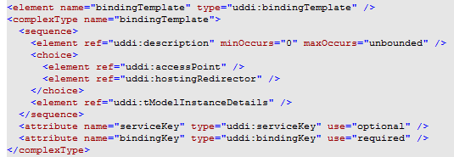
3.bindingTemplate

Slide 3
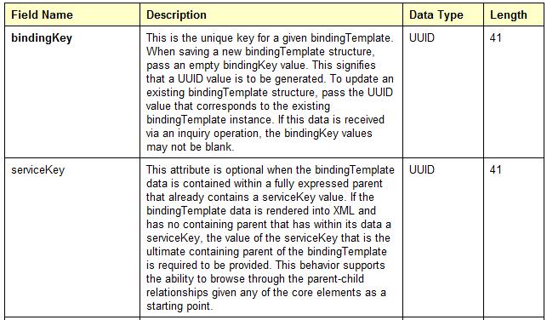
bindingTemplate…

Slide 4
tModel
The tModel is the last core data type, but potentially the most difficult to grasp. tModel stands for technical model.
A tModel is a way of describing the various business, service, and template structures stored within the UDDI registry.
Any abstract concept can be registered within UDDI as a tModel.
For instance, if you define a new WSDL port type, you can define a tModel that represents that port type within UDDI.
Then, you can specify that a given business service implements that port type by associating the tModel with one of that business service's binding templates.

Slide 5
Primary use -tModel
The primary use for tModel elements within UDDI is
To represent a Technical Specification
EX., Wire Protocols , interchange format etc
Two parties technical identity can be registered in a tModel.
Referred using Unique tModel identifier/key
tModel element acts as fingerprints that uniquely designates the spec.

Slide 6
Support for UDDI search capabilities
Two structures used
Identifier Bag (name, value pair :organizational identity)
Category bag (name, value pair : organizational taxonomy information)

Slide 7
tModel Structure
Tmodel
  Name ( Required Searchable element)
  Description
  Overview doc ( Remote references)
    overview URL
  Identifier Bag ( Contains Searchable name , value pair)
    Keyed reference
    Keyed reference
  Category Bag ( Contains Searchable name , value pair)
    Keyed reference
    Keyed reference

Slide 8
A tModel representing the HelloWorldInterface port type
<tModel tModelKey="uuid:xyz987..." operator="http://www.ibm.com"
authorizedName="John Doe">
<name>HelloWorldInterface Port Type</name>
<description>
An interface for a friendly Web service
</description>
<overviewDoc>
<overviewURL> http://localhost/helloworld.wsdl </overviewURL>
</overviewDoc>
</tModel>

Slide 9
Publisher Assertion data structure:
This is a relationship structure putting into association two or more businessEntity structures according to a specific type of relationship, such as subsidiary or department.
The publisherAssertion structure consists of the three elements
fromKey (the first businessKey),
toKey (the second businessKey)
keyedReference.
The keyedReference designates the asserted relationship type in terms of a keyName keyValue pair within a tModel, uniquely referenced by a tModelKey

Slide 10
Ctd.,
<element name="publisherAssertion" type="uddi:publisherAssertion" />
<complexType name="publisherAssertion"> <sequence>
  <element ref="uddi:fromKey" />
  <element ref="uddi:toKey" />
  <element ref="uddi:keyedReference" />
  </sequence>
</complexType>

Slide 11
UDDI Usage
1. Use UDDI Business registry to locate the business entity info. Previously published by a company advertising a Web Service.
2.You either request more specific info. About the business service or request entire business entity structure , this structure contains the relevant binding template info needed to contact the service, you put this binding info into cache

Slide 12
3.You refer to the tmodel key info in the binding template to obtain info to invoke the desired Web Service and use this info to write the program that will access the service
4.The program invokes Web Service using binding template info that has been cached
If call to Web Service fails, refresh binding template info. Refresh cache and keep trying.

